Slide 1
Art Room
Mrs. Barge

Slide 2
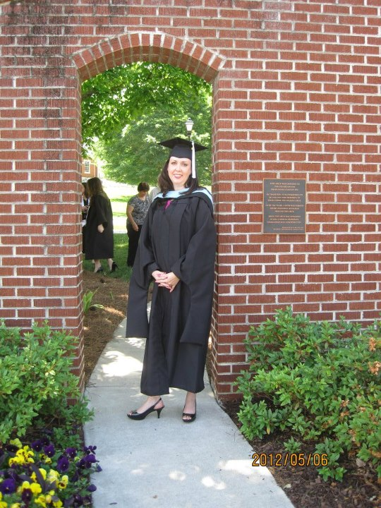
About me Education
BFA degree in Textiles/Surface Design from Georgia State University
Master of Arts in Teaching from North Georgia College and State University
2012
AA from UNG for Media Studies 2017

Slide 3
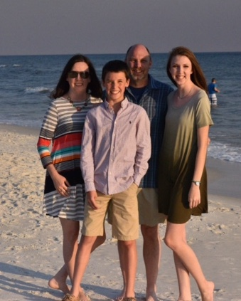
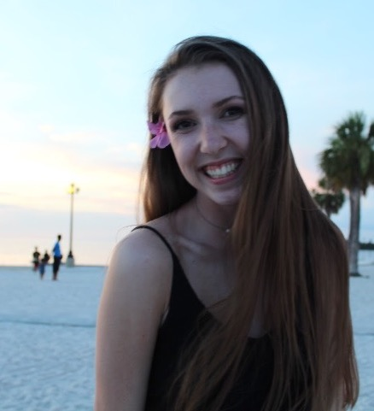
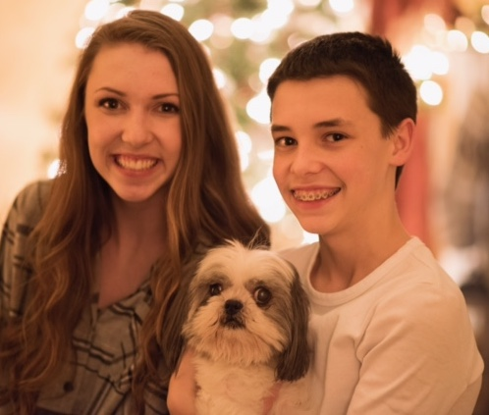
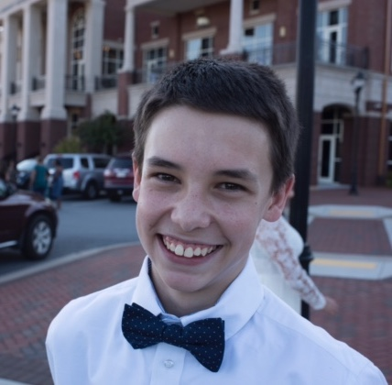
Family
I have a daughter Taylor that is 18 and a son Austin who is 16. I have been married to my husband Tim for 22 years.

Slide 4
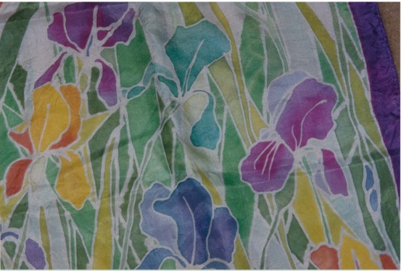
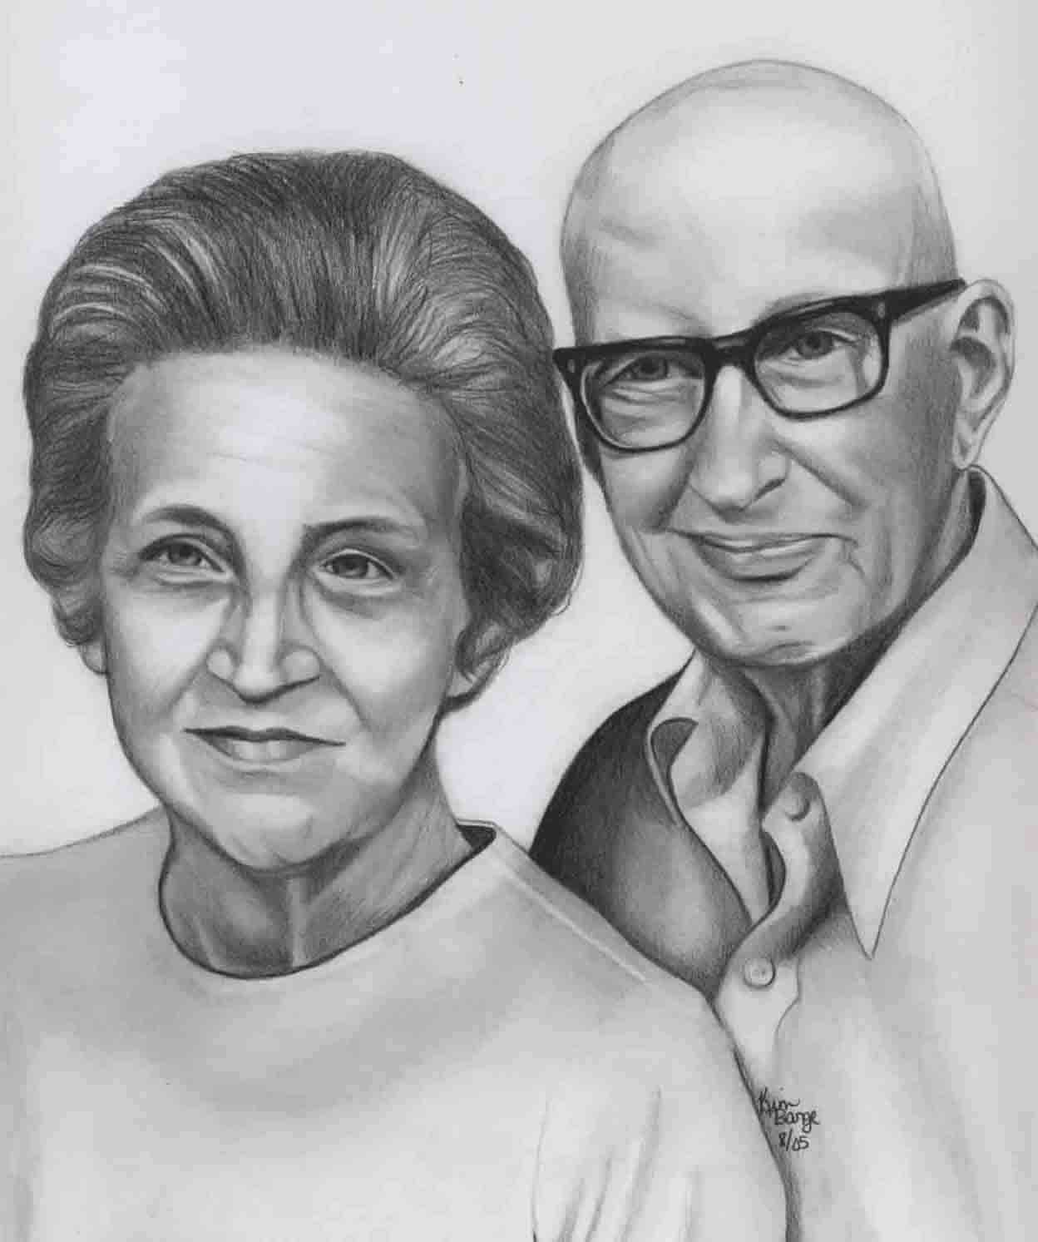
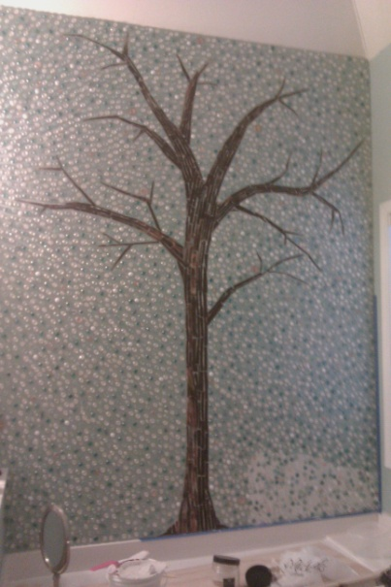
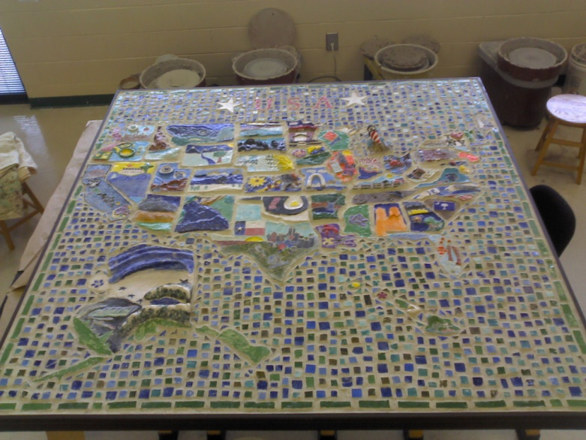
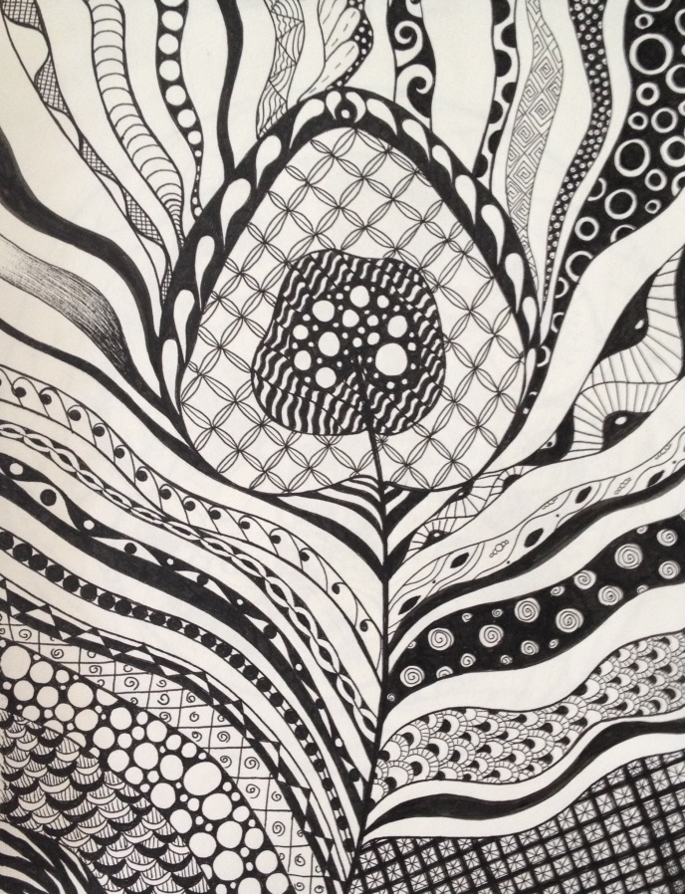
Interests
I enjoy art of all kinds but especially drawing. I also paint, work with clay and create mosaics.
I love a good book, hanging with my friends, relaxing in my hammock, and going to the beach.

Slide 5
Beginning of class Procedures
Come into class quietly and take your seat,
you must be in your seat when the bell rings or
you will get a slip
Once you have chosen your seat the first day, that will be your seat for the remainder of the year
You will be moved if you continue to talk to your neighbor, not pay attention, or continually not follow the rules.
Books go to the tables against the wall.
Students must stay in their seats! Keep trash at your desk until the end of the period

Slide 6
Rules
Be in your seat when the bell rings
Do not talk when I am talking
Respect the room, the supplies, and each other

Slide 7
Procedures
No cell phones
First five minutes of class are for passing out work. Do not go and get your work, wait until I have given instructions
NO food or drink ever in class. If you bring a drink put it on the ledge not on your table
3 bathroom passes per semester!! You must stay in class for safety reasons.

Slide 8
In Case of Emergency
Fire alarm? Go to back door. Line up for roll call. In between classes? Leave building at closest exit and go to your class line. Same if you are in the restroom.
Severe weather
Lock down

Slide 9
What’s new this year?
Brought a book bag to class? Go to the office.
Must have your agenda.
Teachers can only sign the passport page. If you lose your passport pages you must buy a new agenda.
No food in class ever. I will take it up and throw it away. I don’t want to see it, hear it, or see you chewing.
No getting supplies yourself. Ever.
Books go at the tables against the wall.
Slips

Slide 10
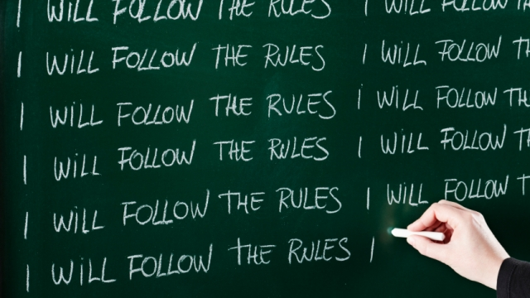
Discipline
Slip #1 - Email home and to coach
Slip #2 – Teacher Detention (Thursday afterschool with Ms. Davis)
Slip #3 - Send to Administration

Slide 11
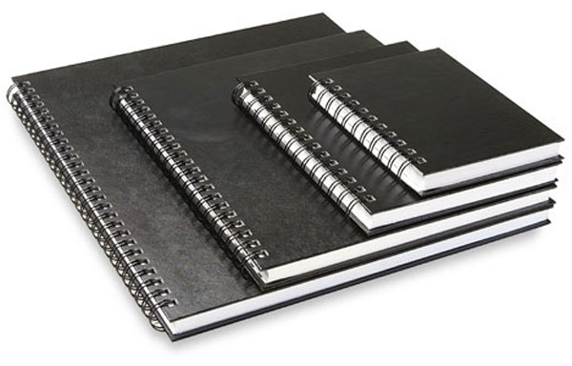
Sketchbooks
You will be given a sketchbook assignment on a Monday and it is due Friday of the next week.
I will grade these and sign them as complete
You must bring your sketchbook to class with you everyday starting on Monday
I am selling them in class for $6.00
It needs to be spiral bound and 8X10 or 9X12 size
You also need a pencil,
Everyday!
Sketchbooks cannot be left in the classroom, EVER

Slide 12
Procedures
Finished your project before it is due? You may work on your sketchbook assignment
Pace yourself! Do not wait until the last minute to get to work. Assignments will be given on Monday and due on Friday.
If you are not working on anything I will give you something to do!

Slide 13
Grading
Assignments | Grade Weights | Grading Scale
Sketchbook | 10% | A - 90 and above
Projects | 40% | B - 80-89
Benchmarks/Final Exam | 30% | C- 74-79
Weekly Quizzes | 15% | D - 70-73
Performance Essay | 5% | F – 69 or below

Slide 14
Grading
Late?
Ten points off for each day late
Only allowed for three days, after three days a 0 will be given
No extra credit, ever

Slide 15
Grading
We will have BREATHE days
Begin Reworking Every Artwork To Help Elevate
These are days where you can rework any assignment for a better grade, get caught up on sketchbook assignments, and read the book for this year.
You should NEVER have homework in this class!

Slide 16
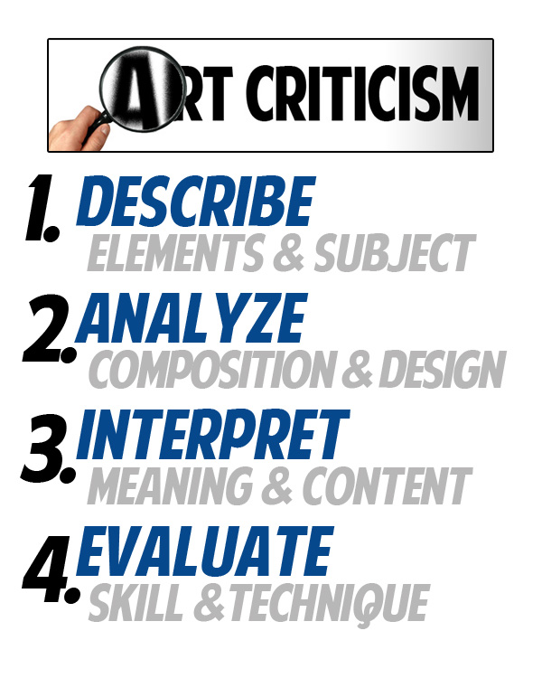
Critique
We will critique often. Get used to it.
I will help you through it the first few times. You are graded on participation and correct use of terms during critique.

Slide 17
Online Art Gallery
Artsonia
https://www.artsonia.com
My website
http://bhsbarge.weebly.com

Slide 18
NAHS
Requirements:
Make at least 3 pieces of art to sell that are good quality finished pieces
3 community service hours
Have GPA of 90 or higher by the end of April
First meeting will be announced soon

Slide 19
Following guidelines and procedures = stress free classroom and a happy teacher

