Slide 1
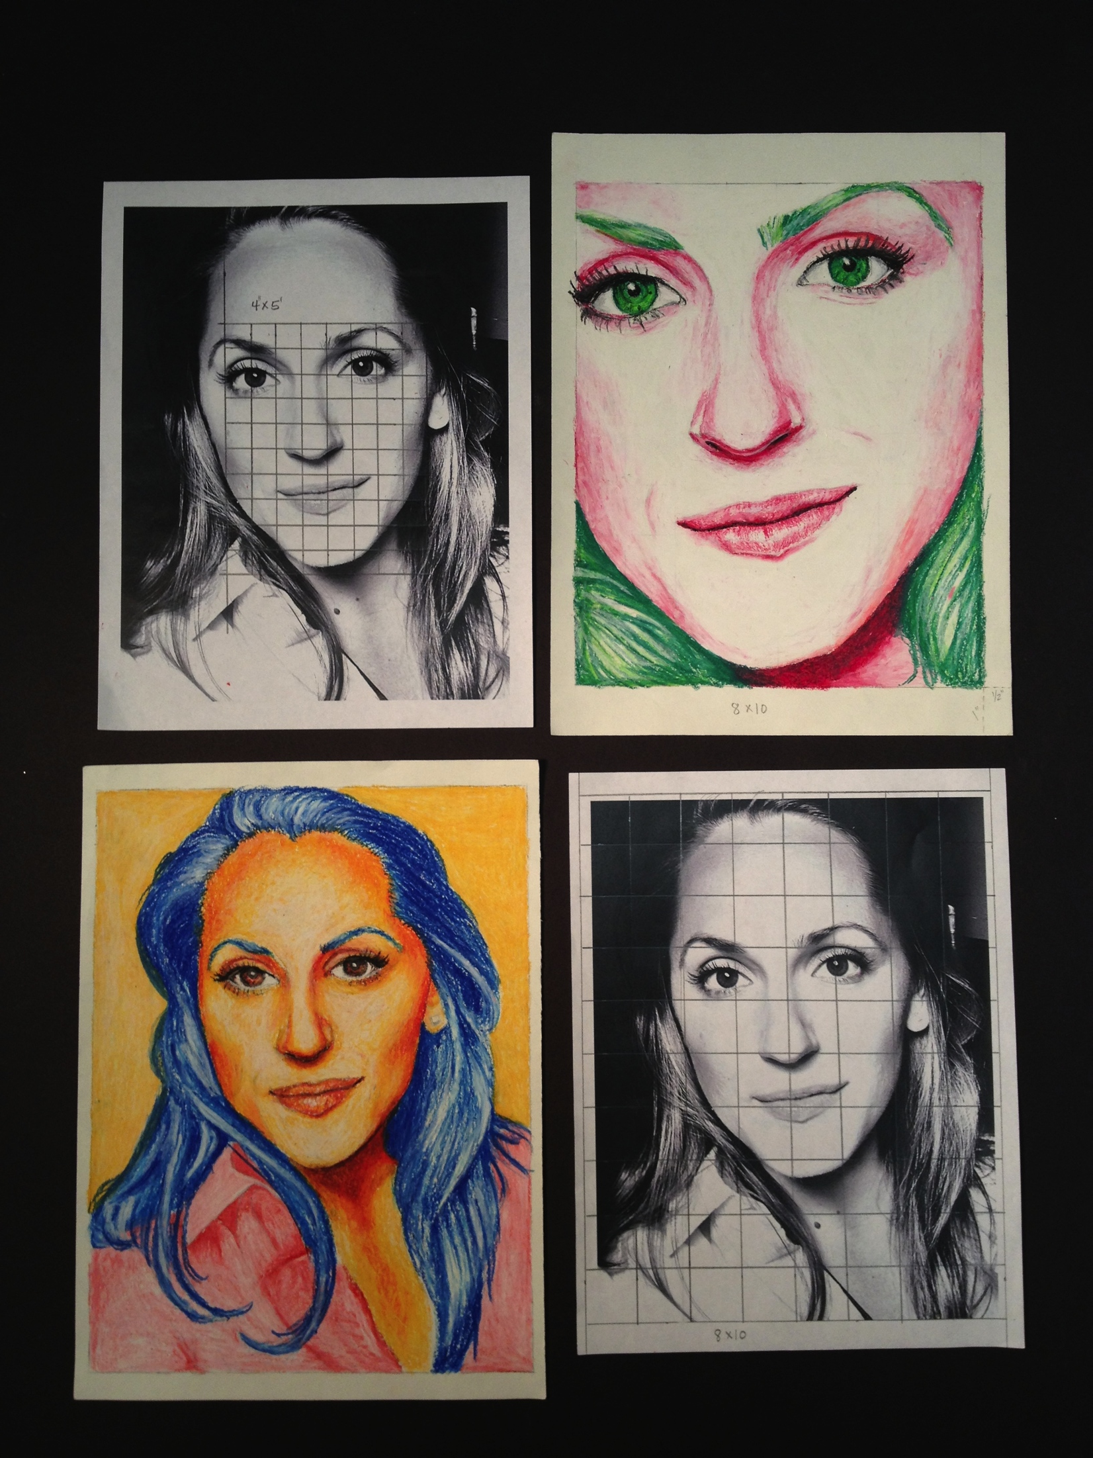
Self Portraits

Slide 2
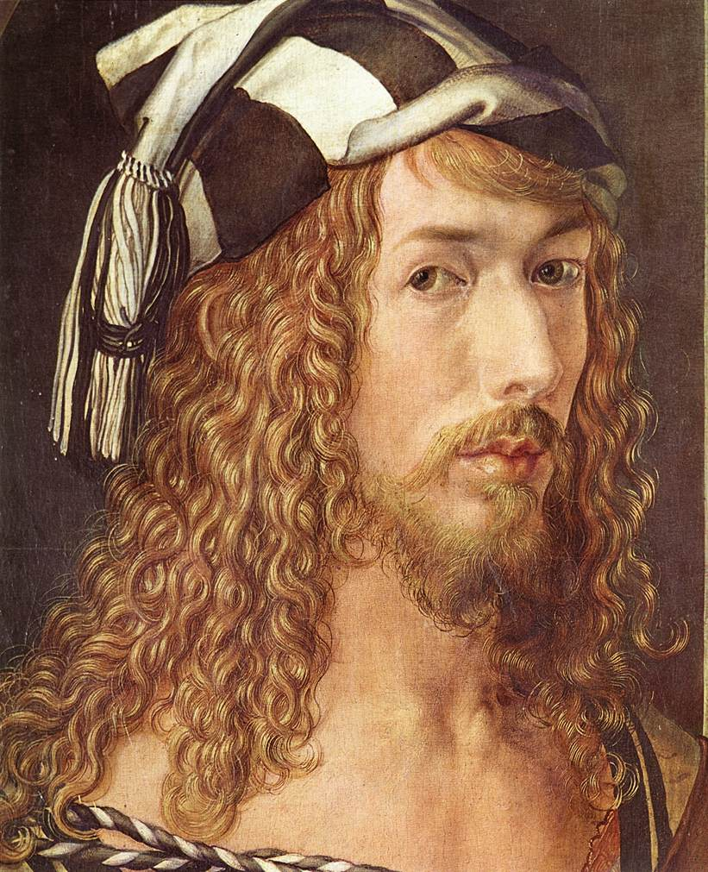
Durer
Dürer is recognized by art historians as being the first artist to regularly paint self-portraits
German painter, printmaker, engraver
From the late 1400’s to the early 1500’s.

Slide 3
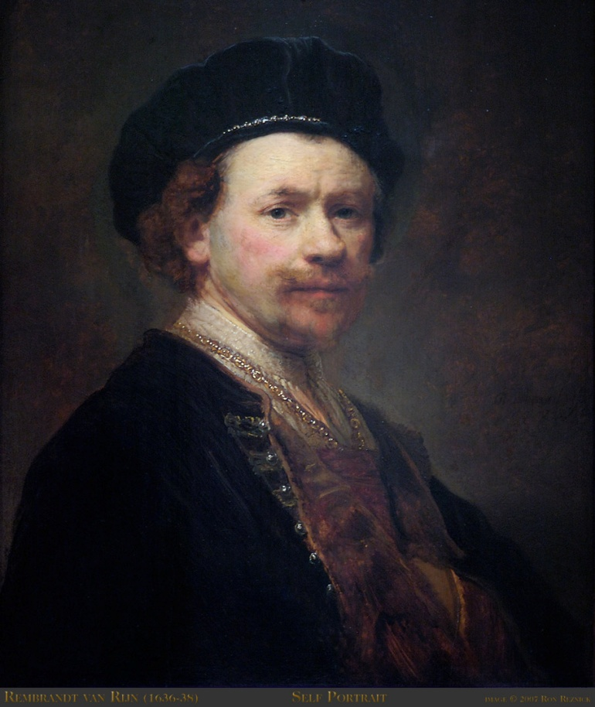
Rembrandt
Dutch artist from the 1600’s
Created around 90 self-portraits (paintings, drawings, and etchings) over 40 years

Slide 4
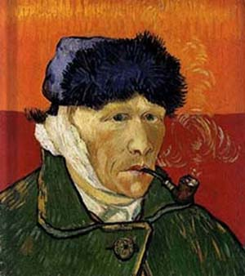
Van Gogh
Post Impressionist painter
1860’s – 1880’s.
Painted around 25 self-portraits

Slide 5
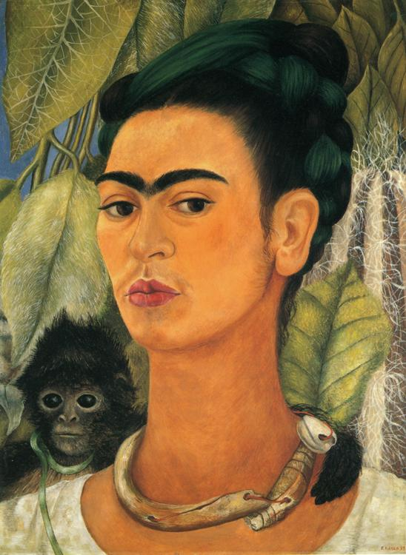
Frida Kahlo
Painted around 55 self-portraits.
Mexican Painter 1930’s – 1950’s
“I paint myself because I am so often alone and because I am the subject I know best.”

Slide 6
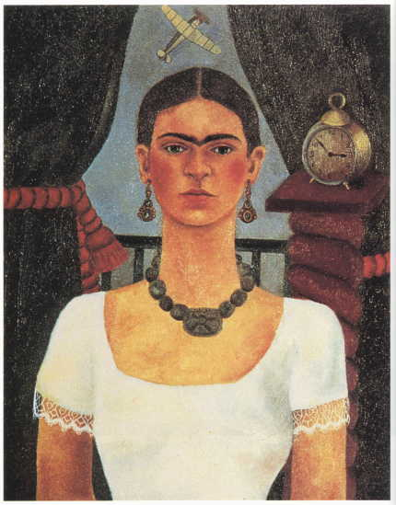
Frida Kahlo did not think very highly of herself. She did not value herself. This negativity comes through in her work.

Slide 7
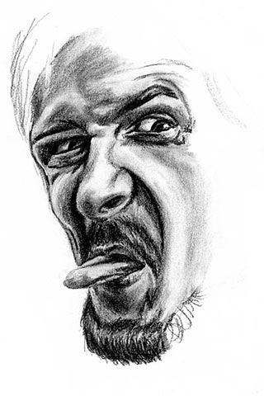
These are both portraits of faces. But the
technique used is very different. Portraits can
be painted in any way the artist chooses but first you must learn where
the parts of the face go.

Slide 8
Face Proportions
Proportion-
proper relation between things or parts
2. a portion or part in its
relation to the whole
The proportions of the head can be divided horizontally into four equal quarters.
1. The first quarter measures from the top of the head down to the hairline.
2. The second quarter measures from the hairline down to the eyes in the middle of the head.

Slide 9
Terms
Self-portrait – A painting or drawing that an artist has created using them self as the subject
Proportion – How one part of an object relates to a whole object, such as the size of an arm in relation to the rest of the body
Grid drawing- Using lines as a way to make a drawing have appropriate proportions.
Contour drawing – Contour is a French word meaning outline. Contour drawings are outlines without any shading or value.

Slide 10
Grid Drawing
Create a one-inch grid on your paper
Make sure that you mark the left and right side of the paper before drawing lines to ensure that the lines are straight.
Create a contour (lines only) drawing of your face and neck
Draw lightly! All lines will be erased.
Due Thursday, August 16th
Critique on Friday, August 17th

