Slide 1
Form
Our 5th Element of Art

Slide 2
Form
Form is the 5th Element of Art we will learn about this year.
Form is 3-D. It has H X W X D.

Slide 3
Clay Terms
Slip – “glue” made by mixing clay with water.
Score – marks on clay to help join two pieces together
Additive – Adding clay to your piece
Subtractive – Taking clay away from your piece
Incising – Using a sharp tool to draw designs onto clay

Slide 4
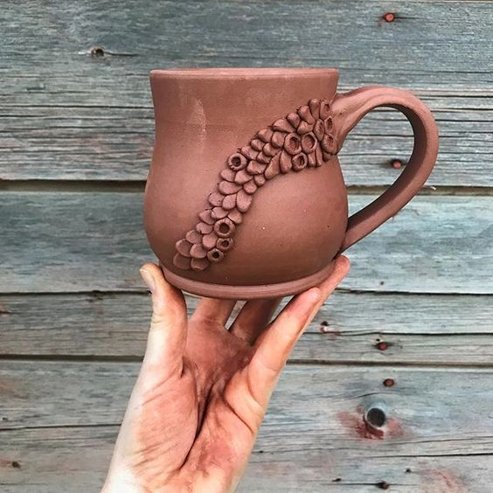
Project
You are creating a mug. The mug must have a bottom, a handle, and a cylinder for the sides.
We will start with a slab of clay.
You will add designs to make your mug unique
Add a lip to the bottom of your mug.

Slide 5
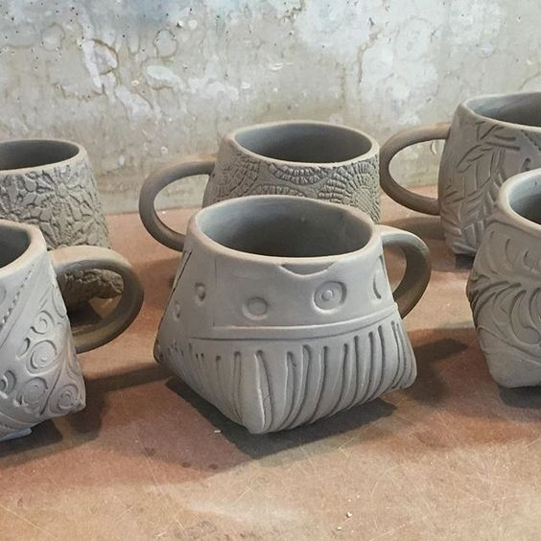
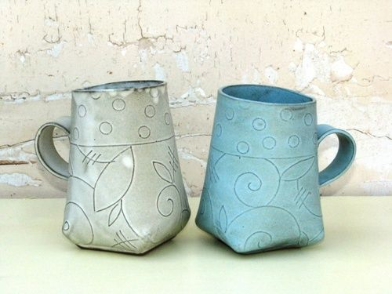
Incising

Slide 6
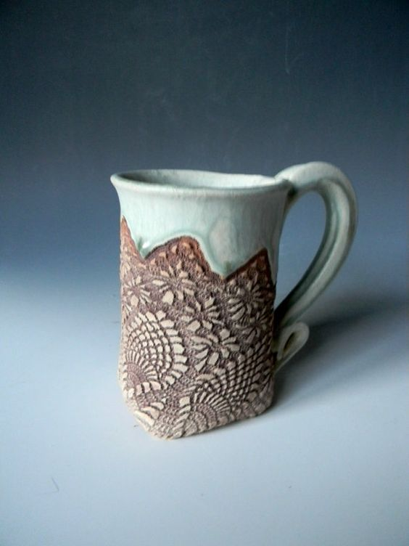
Add designs

Slide 7
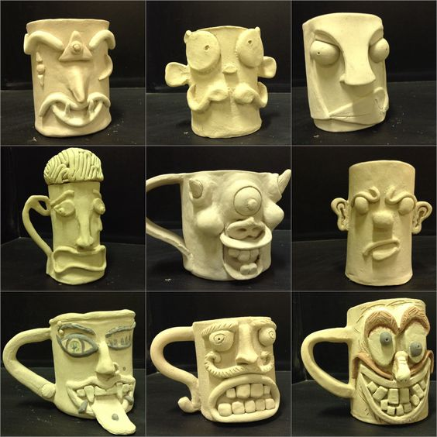
Be creative!

Slide 8
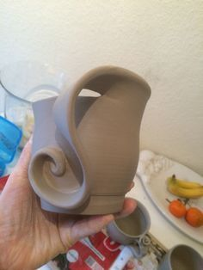
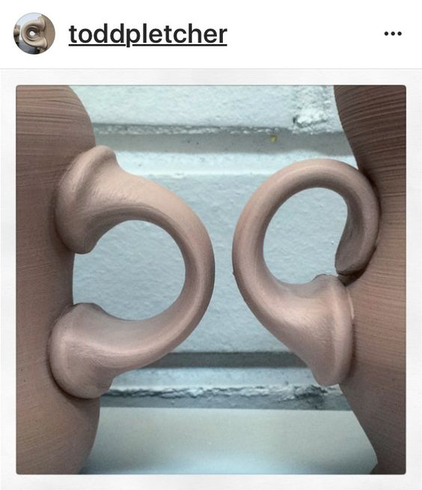
Choose an interesting handle

Slide 9
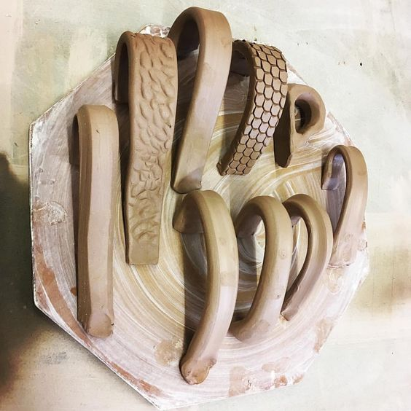

Slide 10
So how do you make a mug?
Basic mug instructions:
https://www.youtube.com/watch?v=6FC-IRuXzPI - action=share
Advanced instructions for square bottom:
https://www.youtube.com/watch?v=w63bZyZ9svo&feature=youtu.be

Slide 11
Directions
Roll slab – Coach Fowler’s room
Cut the slab at least 4” x 10”. If you have room with your slab you can go taller than 4”.
You also need a three inch circle – use the tape roll or the circle cutter
Attach the rectangle to the circle with the slip and score method.
Round off the top of the mug so it doesn’t have any sharp edges.
Create a lip on the bottom (demo on advanced video)

Slide 12
Directions
Create your handle with the left over clay. Be creative!
Allow mug to set up for one day while you come up with your design.
Are you going to carve into your mug? Add clay? Add patterns? Google clay designs. Everyone’s mug should be unique!
Mugs will dry for a few days, get fired in the kiln, then we will glaze them.
Use any leftover clay to create pendants, beads, ornaments, etc. for the sale in December.
Check out my Pinterest board for ideas:
https://www.pinterest.com/kimberlyb16/ceramics/

