Slide 1
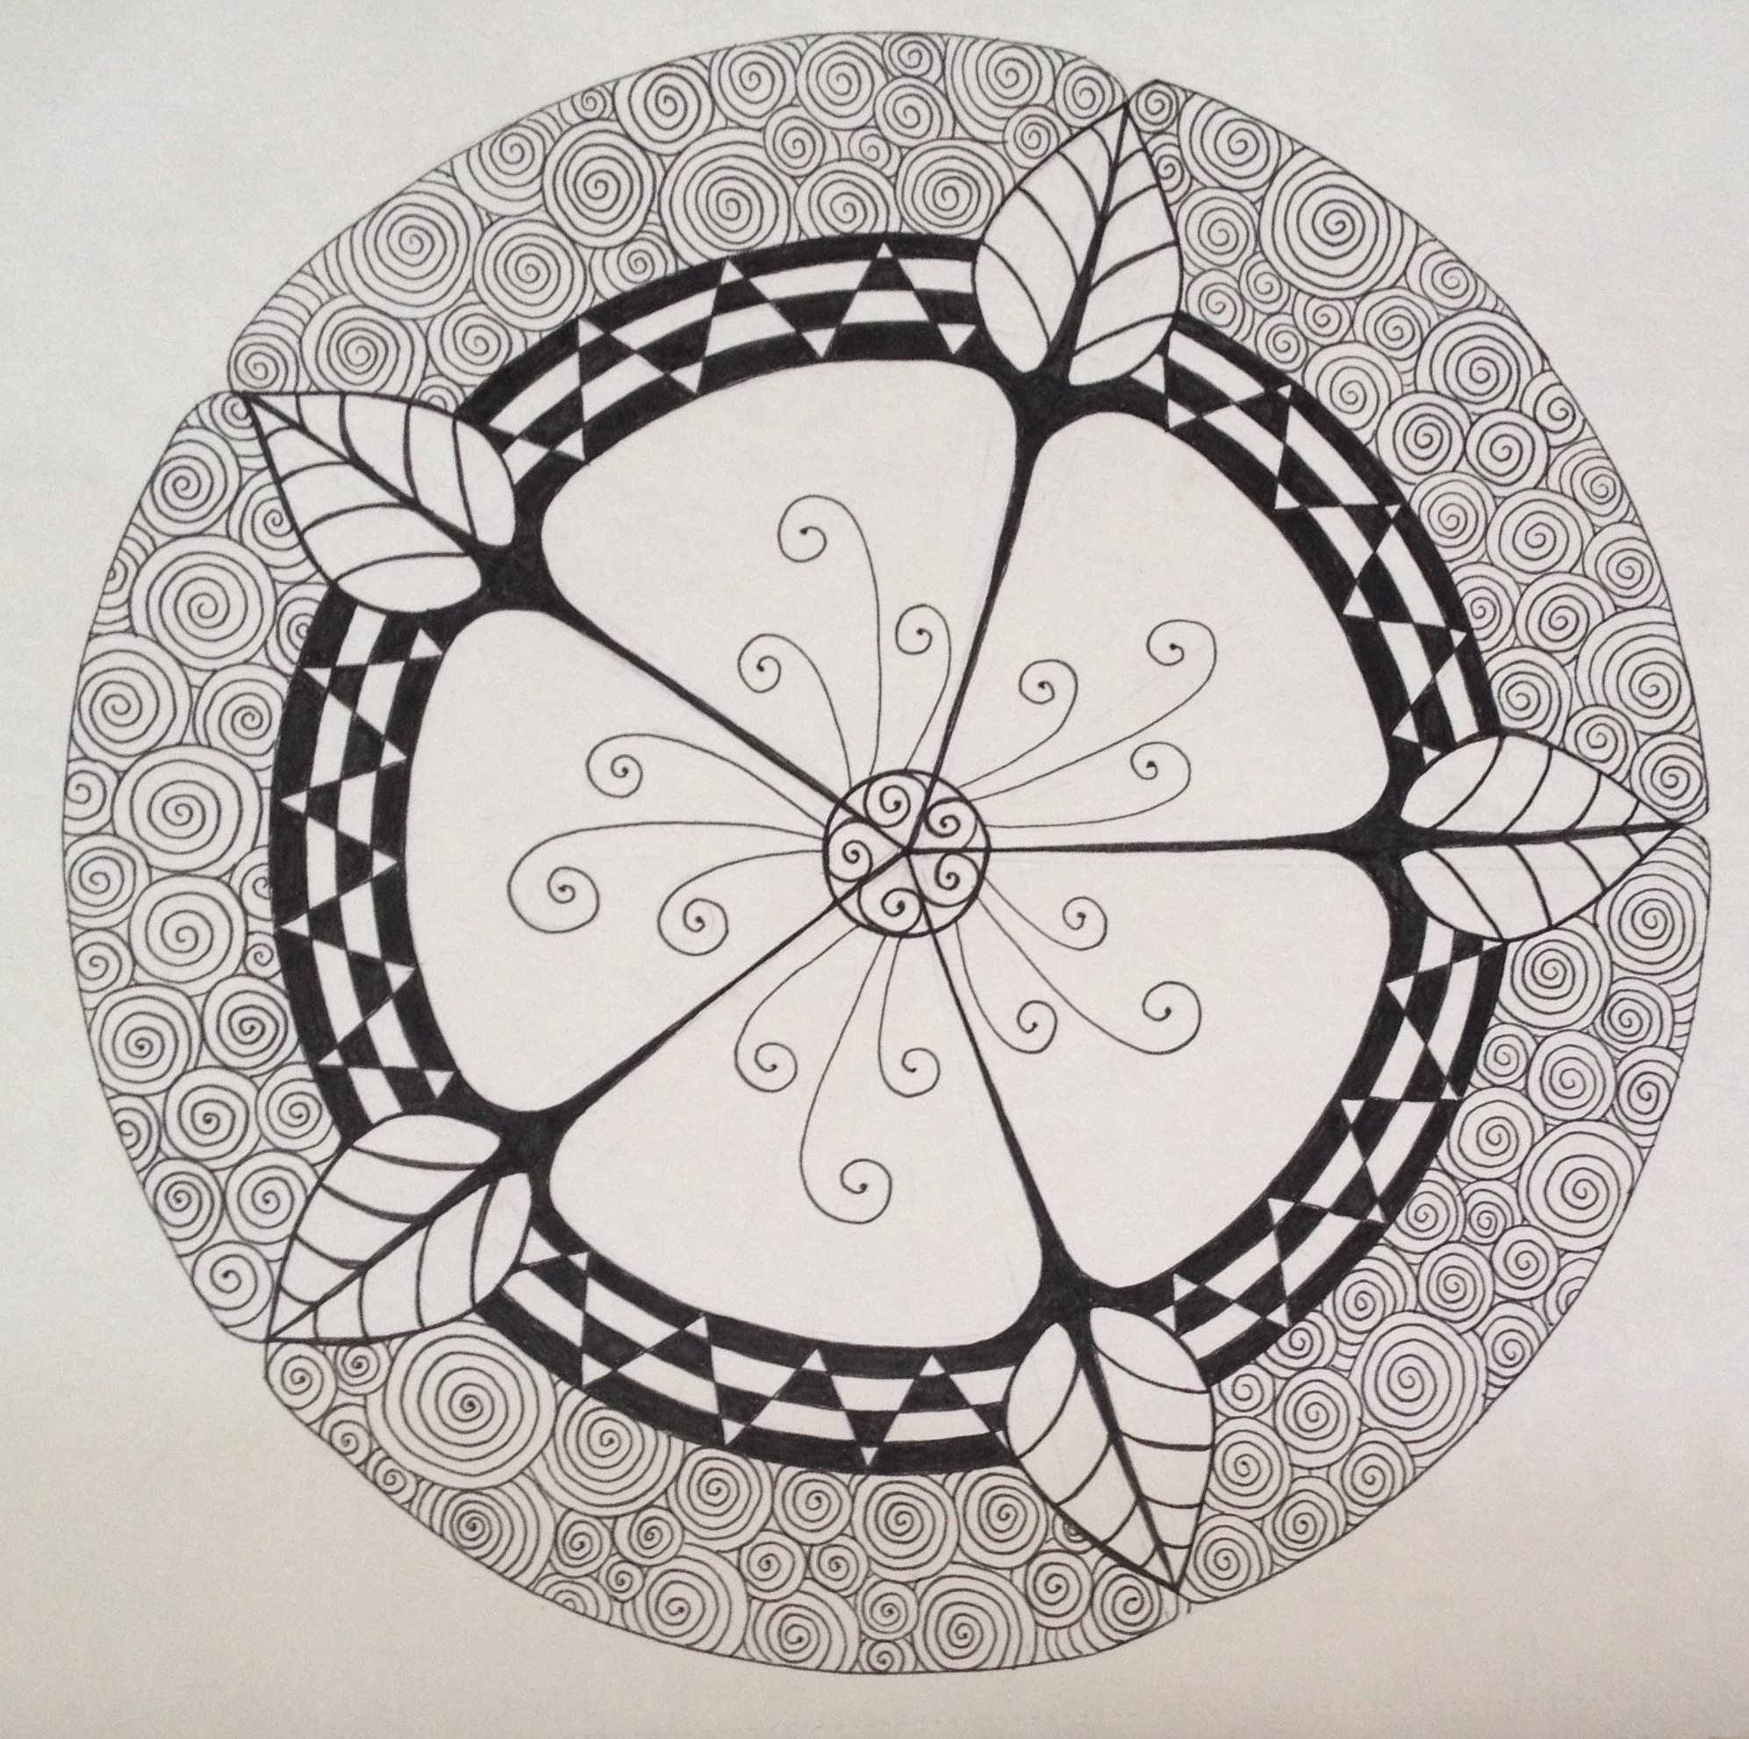
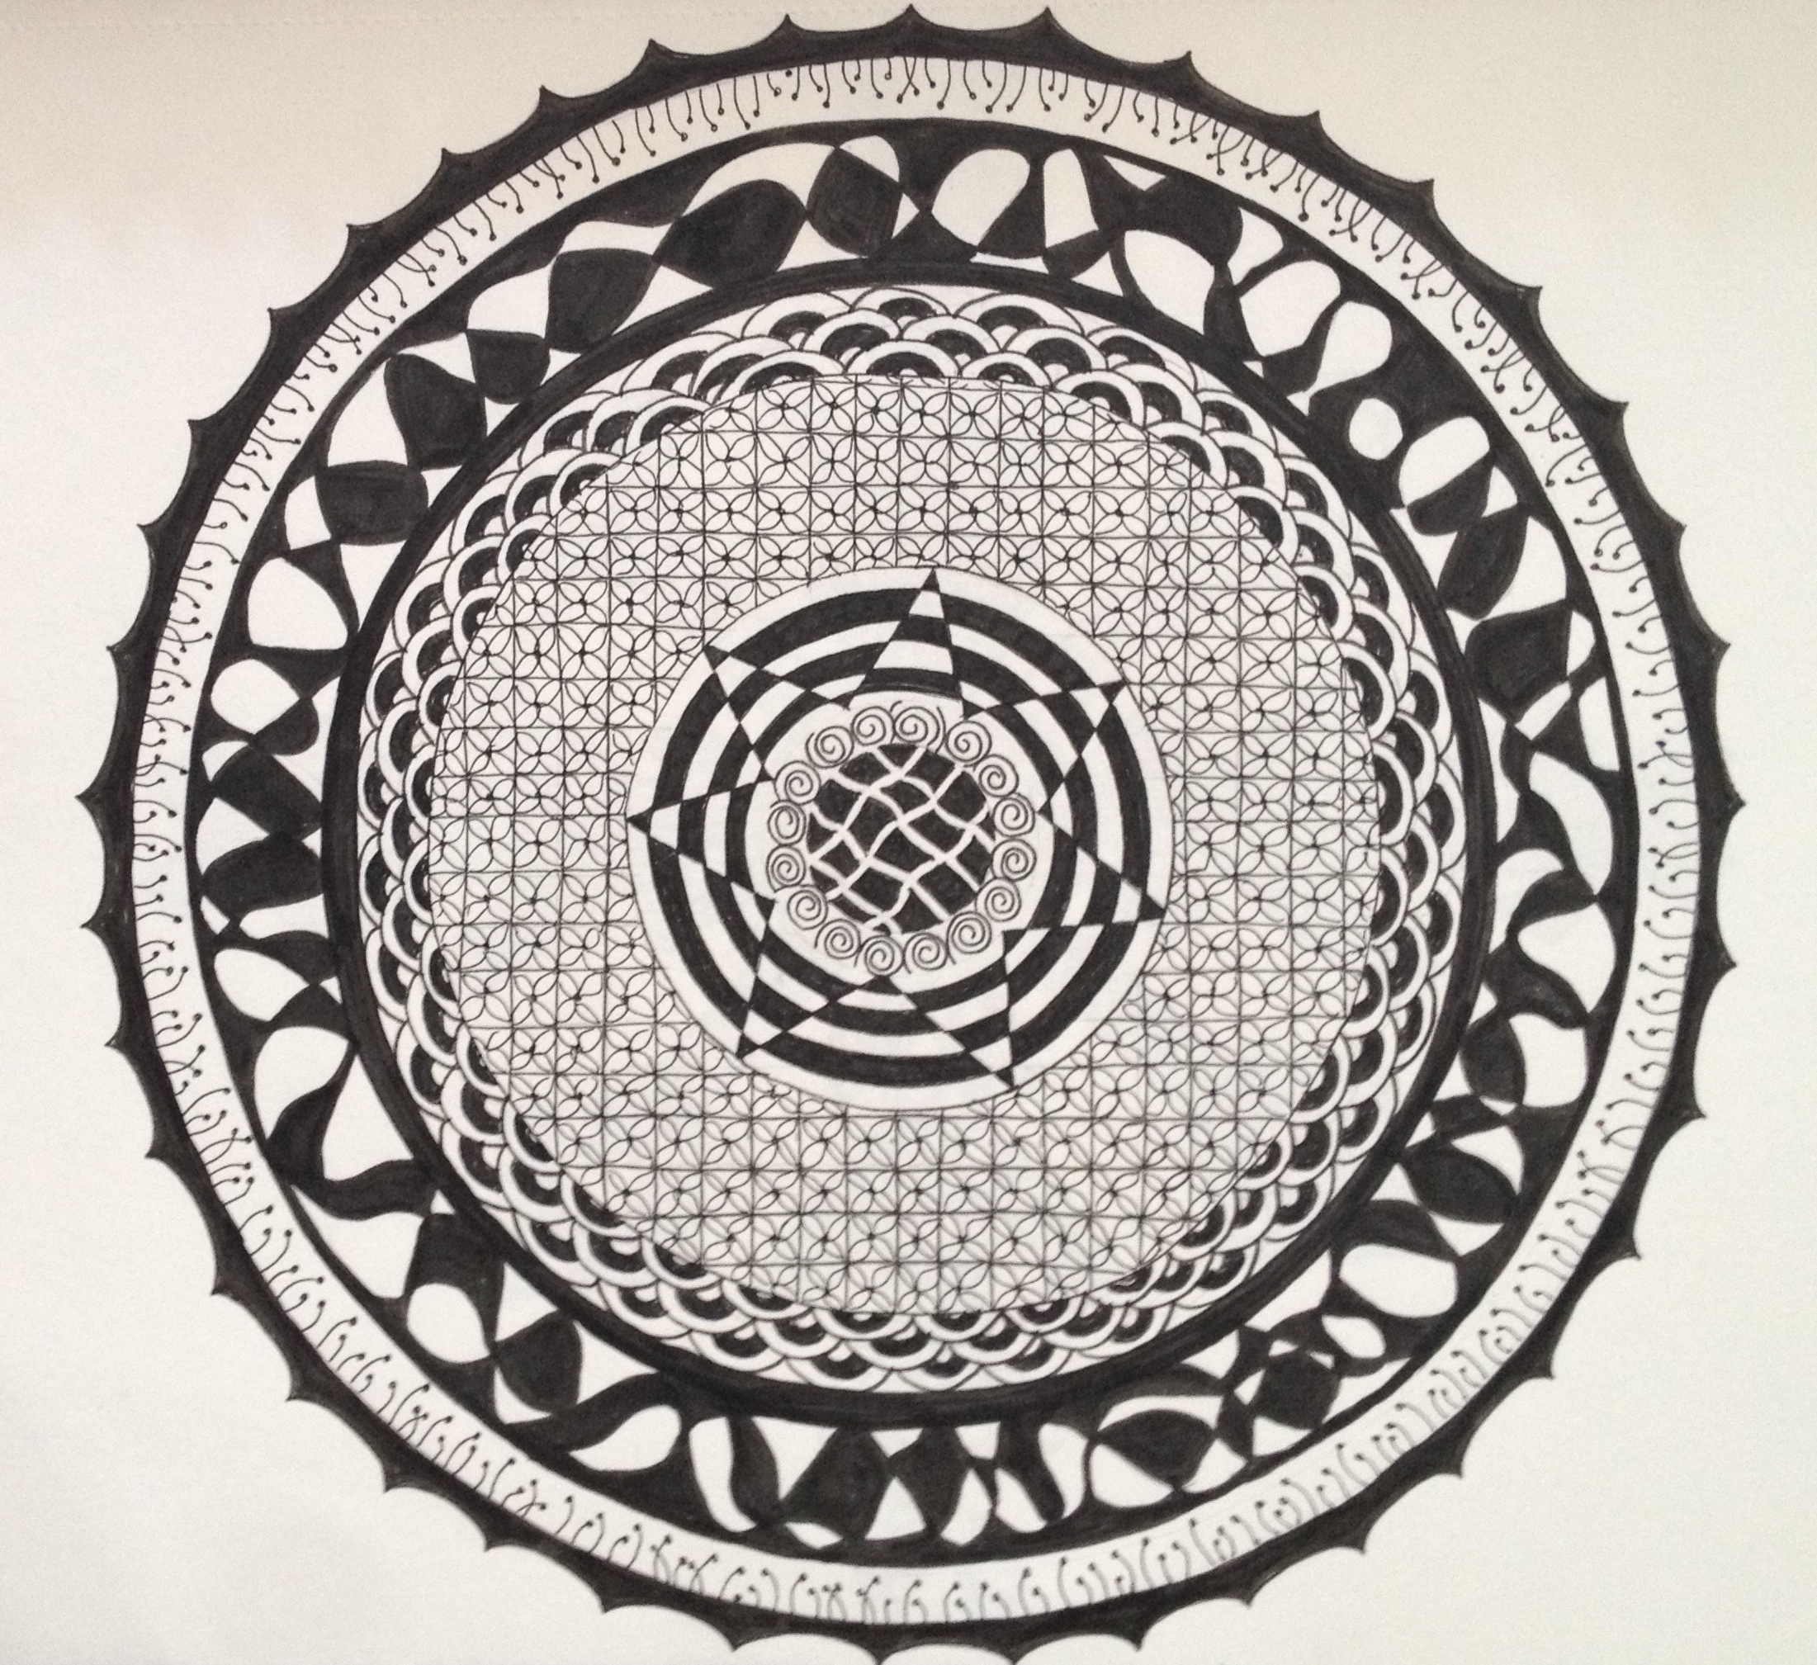
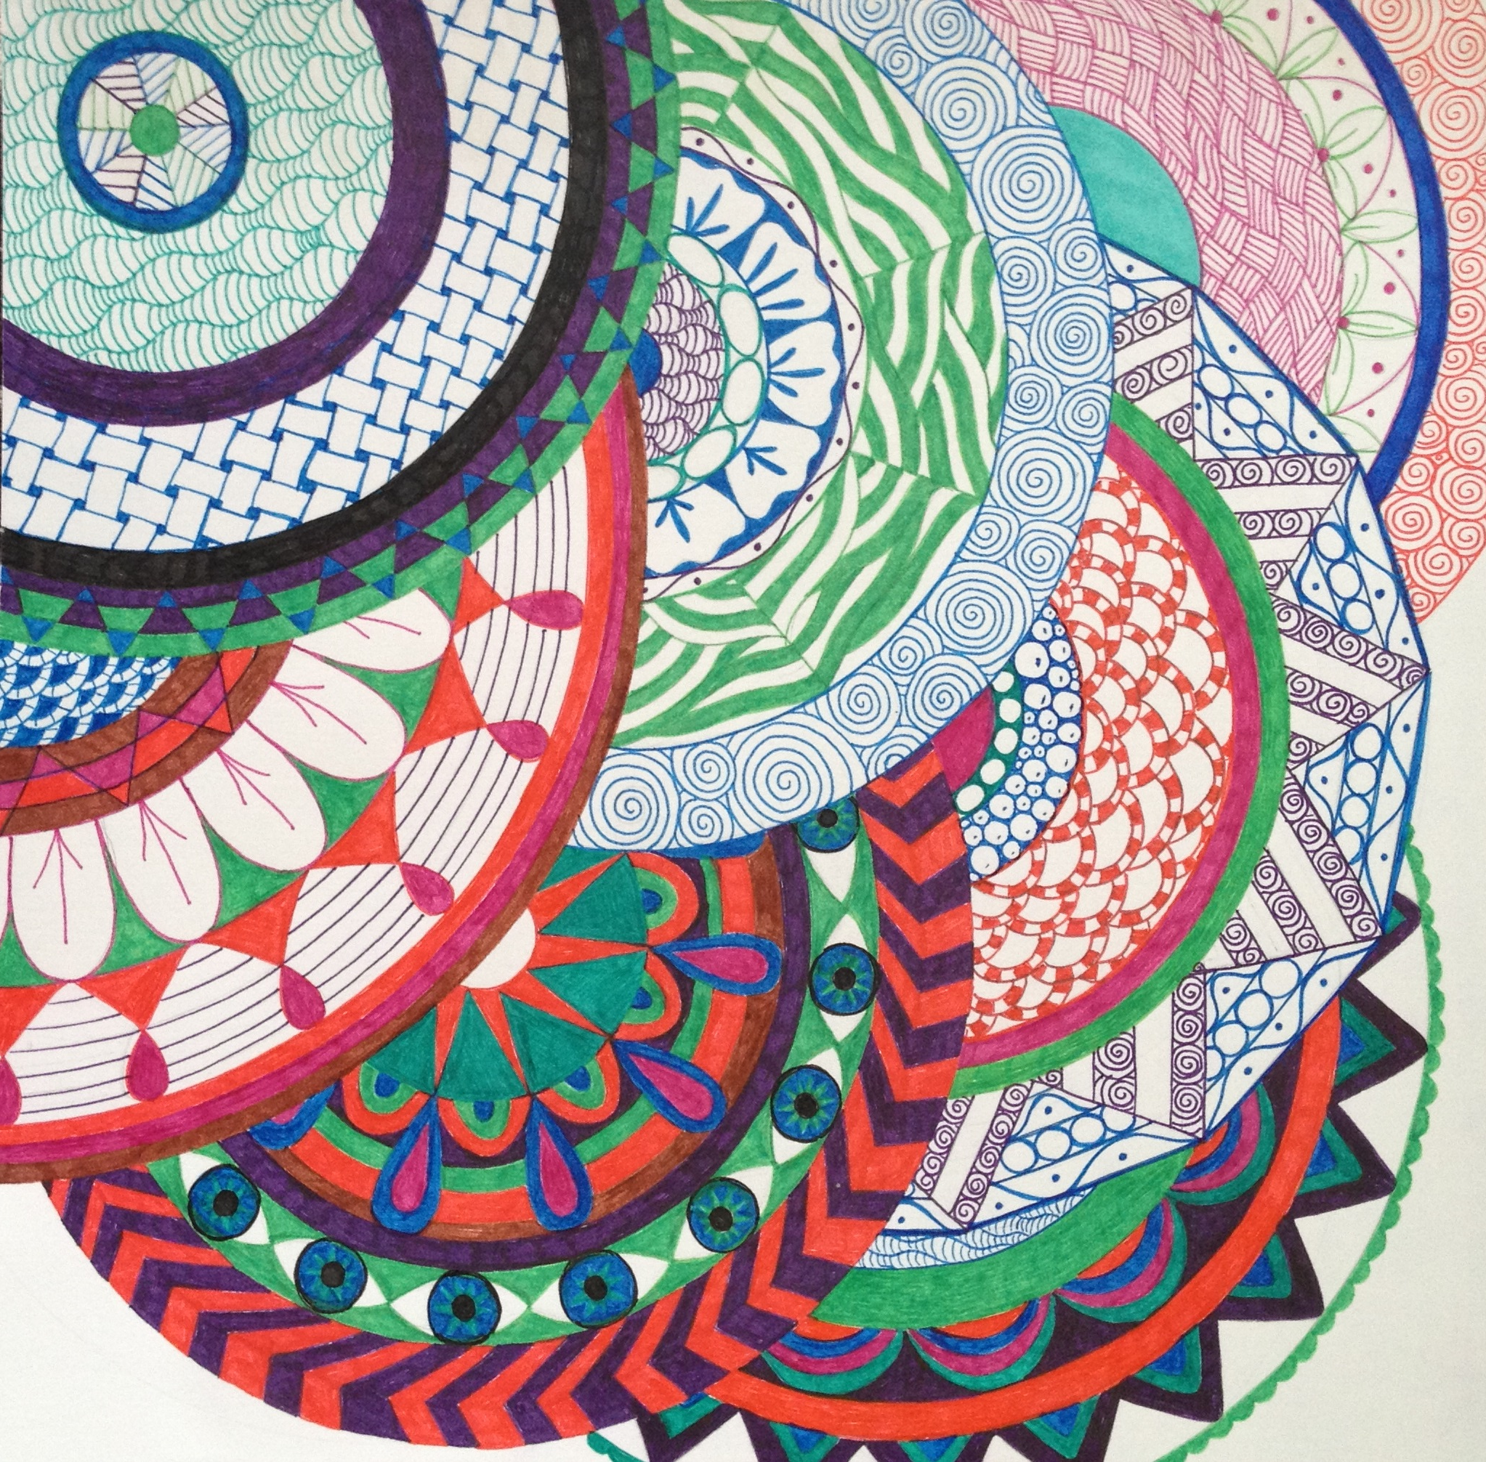
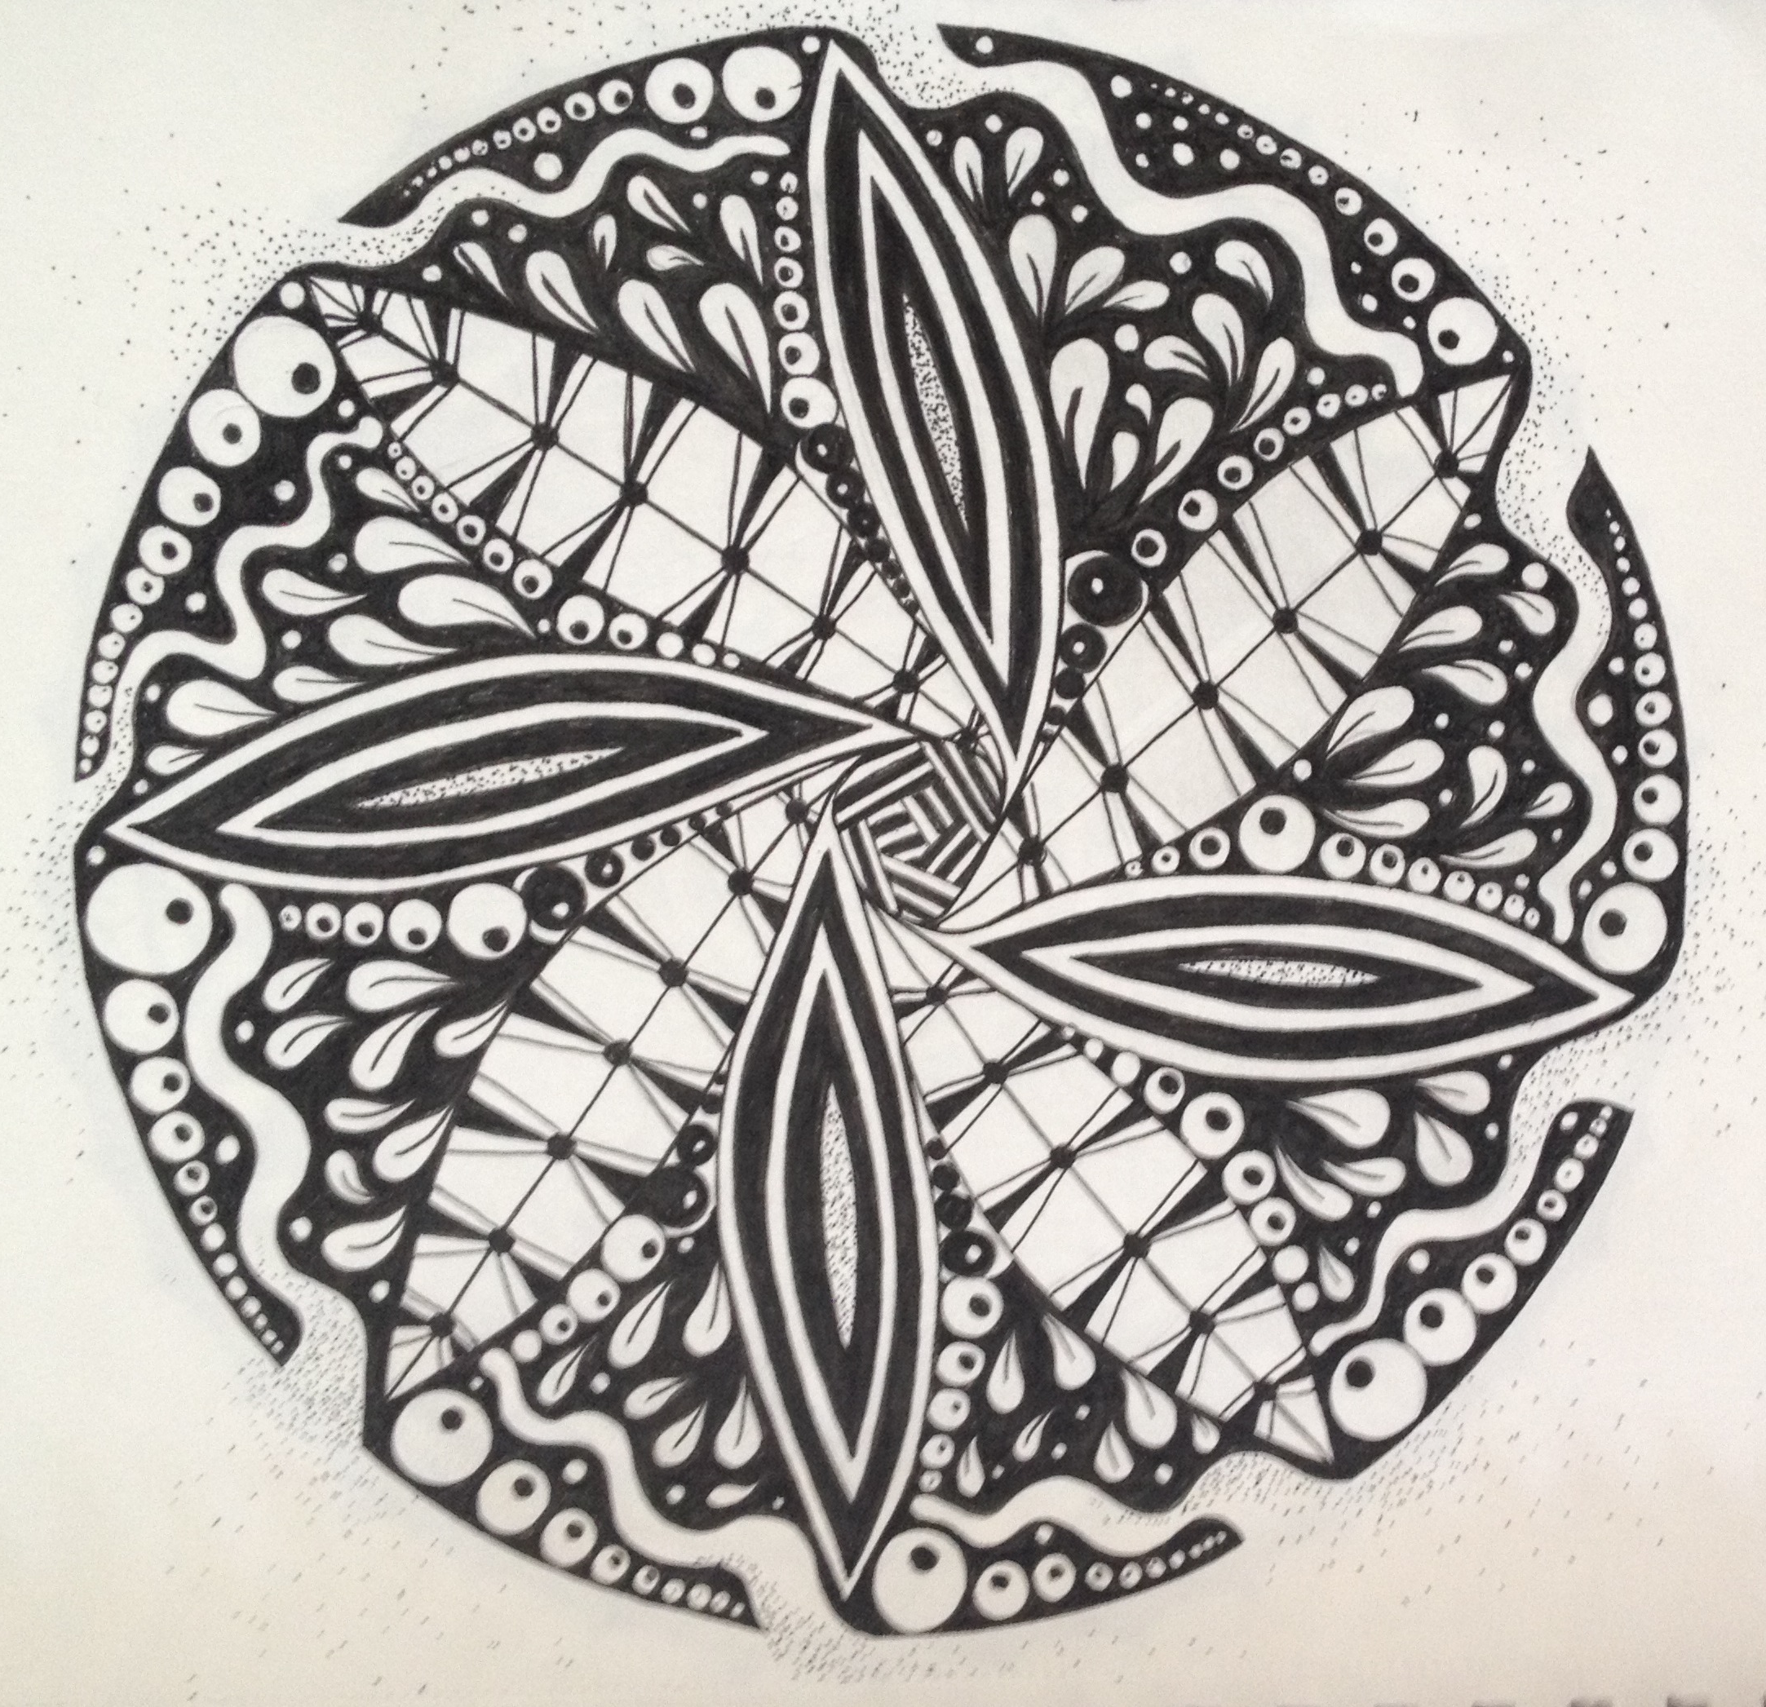
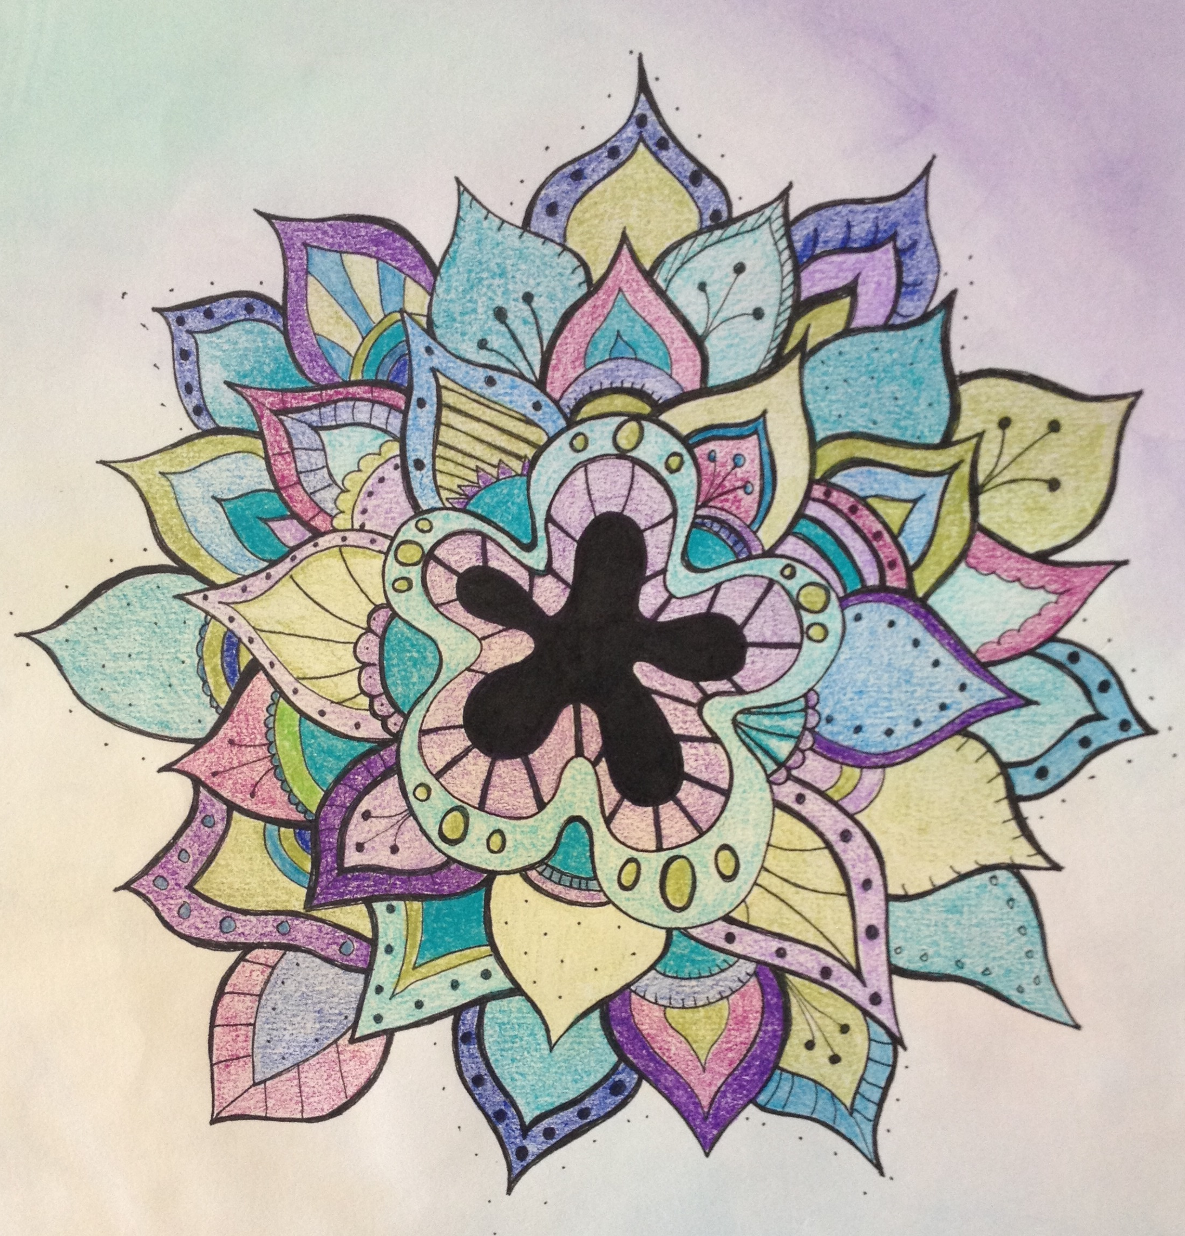
Mandalas

Slide 2
In art, Mandalas refer to artwork created in a circular format.

Slide 3
Your Assignment
Create a 10 x 10 circle and fill with a repeated pattern. Be sure to use the entire circle.
This mandala is created using your name!

Slide 4
Art Terms
Mandala – Art in a circular format
Pattern – A repeated decorative design
Symmetrical design – Design where one side of the composition mirrors the other.
Radial composition – Visual balance in which the design extends from the center.

Slide 5
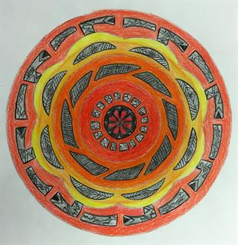
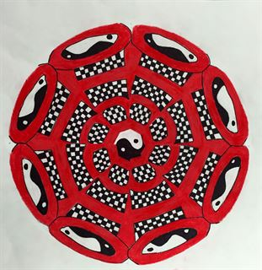
Check out these examples!

Slide 6
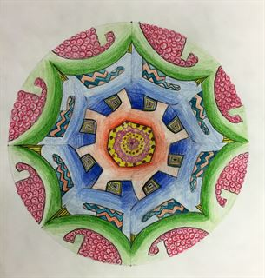
Notice color schemes

Slide 7
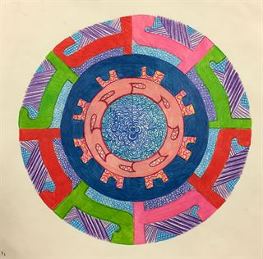
Notice interesting patterns

Slide 8
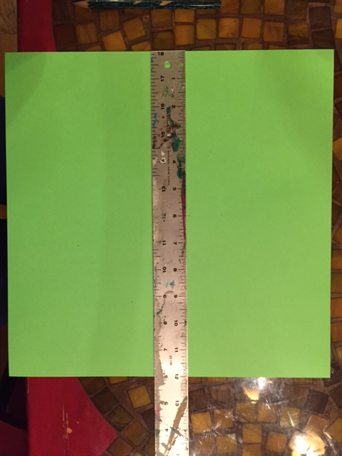
Step 1 Draw a 10X10 circle
Find the center of your paper. Your paper is 12x12 so measure 6 inches from the top and side. Mark the center.

Slide 9
From the center mark measure over 5 inches.

Slide 10
Place the compass on the center and the pencil of the compass on the 5 inch mark. Draw the circle.

Slide 11
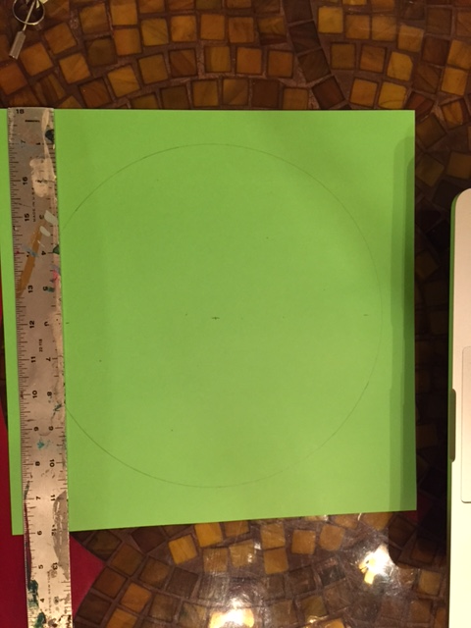
Divide your circle
Measure 6 inches from the edge of your paper on the top and on the bottom of your circle. Connect the marks. This divides your circle in half vertically.

Slide 12
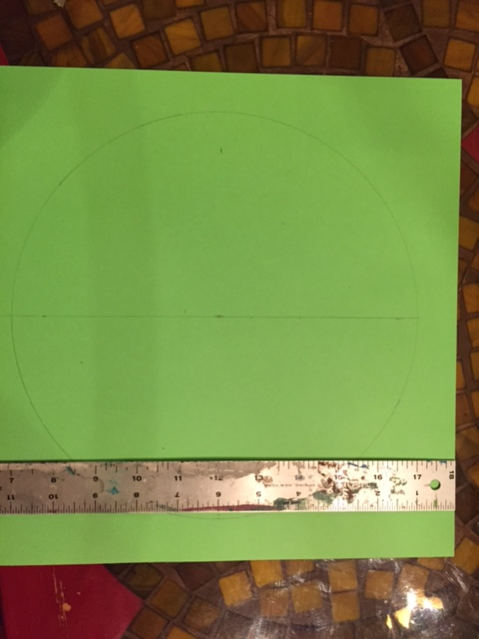
Measure 6 inches from the left side and the right side of your circle. Connect the dots. This divides your circle in half horizontally.

Slide 13
Place the ruler at the corners of the paper (diagonally). Make sure the ruler is touching your center mark, Draw that line. This divides your circle in half diagonally.

Slide 14
Place the rule at the other two corners and repeat. You now have a circle with 8 equal pieces. Write your name in pencil on the back of your paper. Put this paper aside. Grab a sheet of scrap paper for the next step

Slide 15
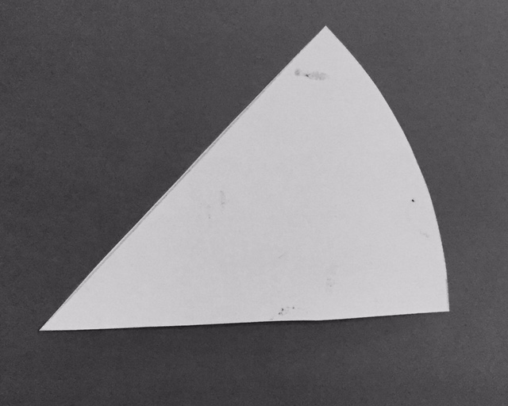
Designing your piece of pie
Take the template and trace onto the scrap paper.
Cut this out carefully and write your name with a pencil on the back.

Slide 16
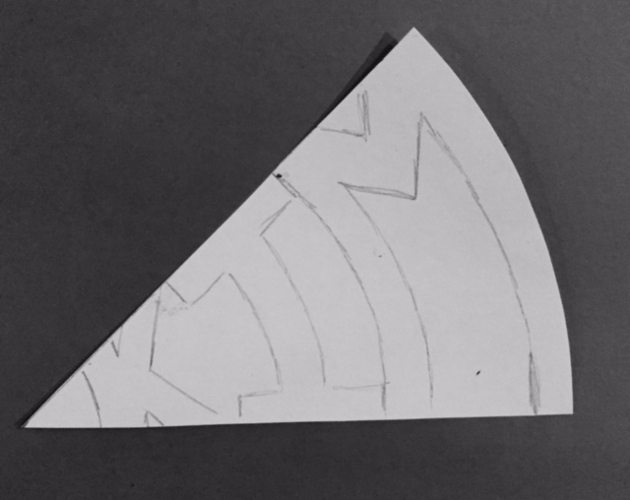
Create your design
Draw the letters of your name, 4 max.
Fill the entire space
The letters must curve with the piece. Notice how the M curves with the outer edge of the piece of pie.
The letters must touch. Do not leave space in between.
Keep the thickness of the letters the same.

Slide 17
Trace the piece onto your 10x10 circle 8 times. Go slowly and neatly.

Slide 18
Add designs
Notice the negative space within your name.
Add patterns in the negative space. Not inside your letters.
Create the designs on the 12 x 12 paper not on your piece of pie shown here.

Slide 19
Now add color with colored pencils.
Choose your color scheme carefully.
Color neatly and slowly with colored pencils.
Due Thursday, February 7th
Critique on Friday, February 8th

