Slide 1
Value

Slide 2
Value
Value is one of the Elements of Art. It is a range from highlight (the brightest highlight being white) to shadow (the darkest being black) and all of the tones in between.
Essentially it’s lightness and darkness

Slide 3
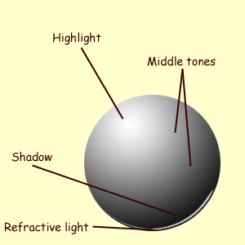
Value Scale

Slide 4
Value with shading

Slide 5
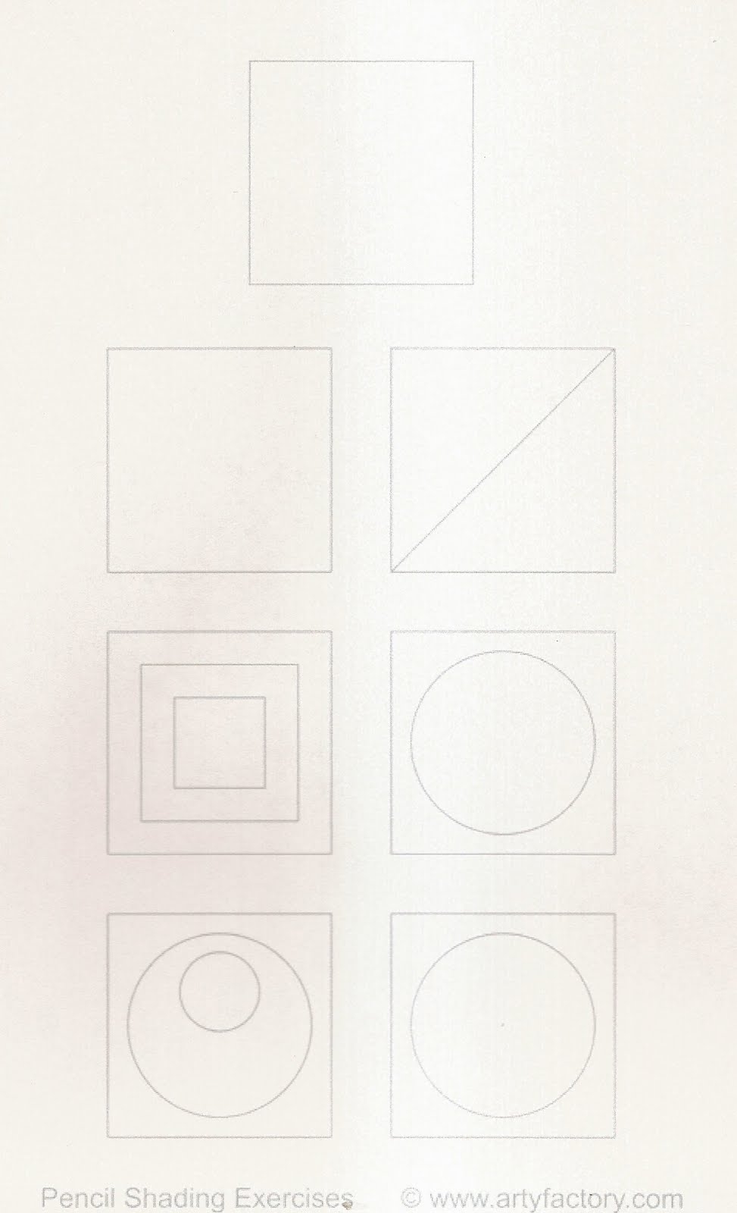
Value worksheet

Slide 6
Cube drawing with 3 point value scale

Slide 7
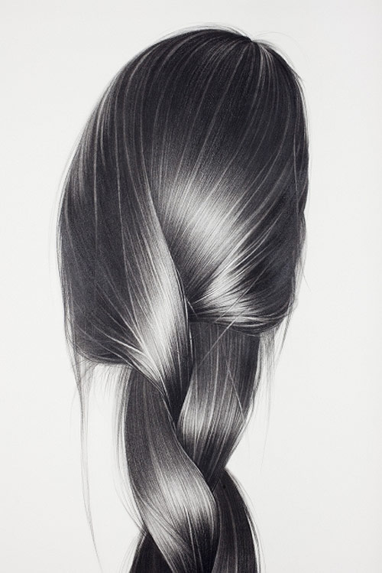
Lets practice hair!
1. Create a medium gray tone first
2. Add darks
3. Erase highlights

Slide 8
Adding value to your drawing
Lightly trace your contour drawing onto a new sheet of drawing paper
Slowly build up value with layers of graphite
Do not go dark until you are almost finished. This will smear all over your drawing as you work.
When you finish you should have blacks, whites, and several shades of gray.
Due October 4th

Slide 9
Full value drawing

